Slide 1


Santosh Kumar Kar,
skkar.2k2@gmail.com

Slide 2
CHAPTER – 5
Spring Cloud Config
Santosh Kumar Kar,
skkar.2k2@gmail.com

Slide 3

Spring Cloud

Slide 4
What is Spring Cloud?
Spring Cloud provides tools for developers to quickly build some of the common patterns in distributed systems, e.g.
configuration management
service discovery
circuit breakers
Routing and messaging
micro-proxy
one-time tokens
global locks
distributed sessions,
cluster state
…… More

Slide 5
Spring Cloud Config

Slide 6
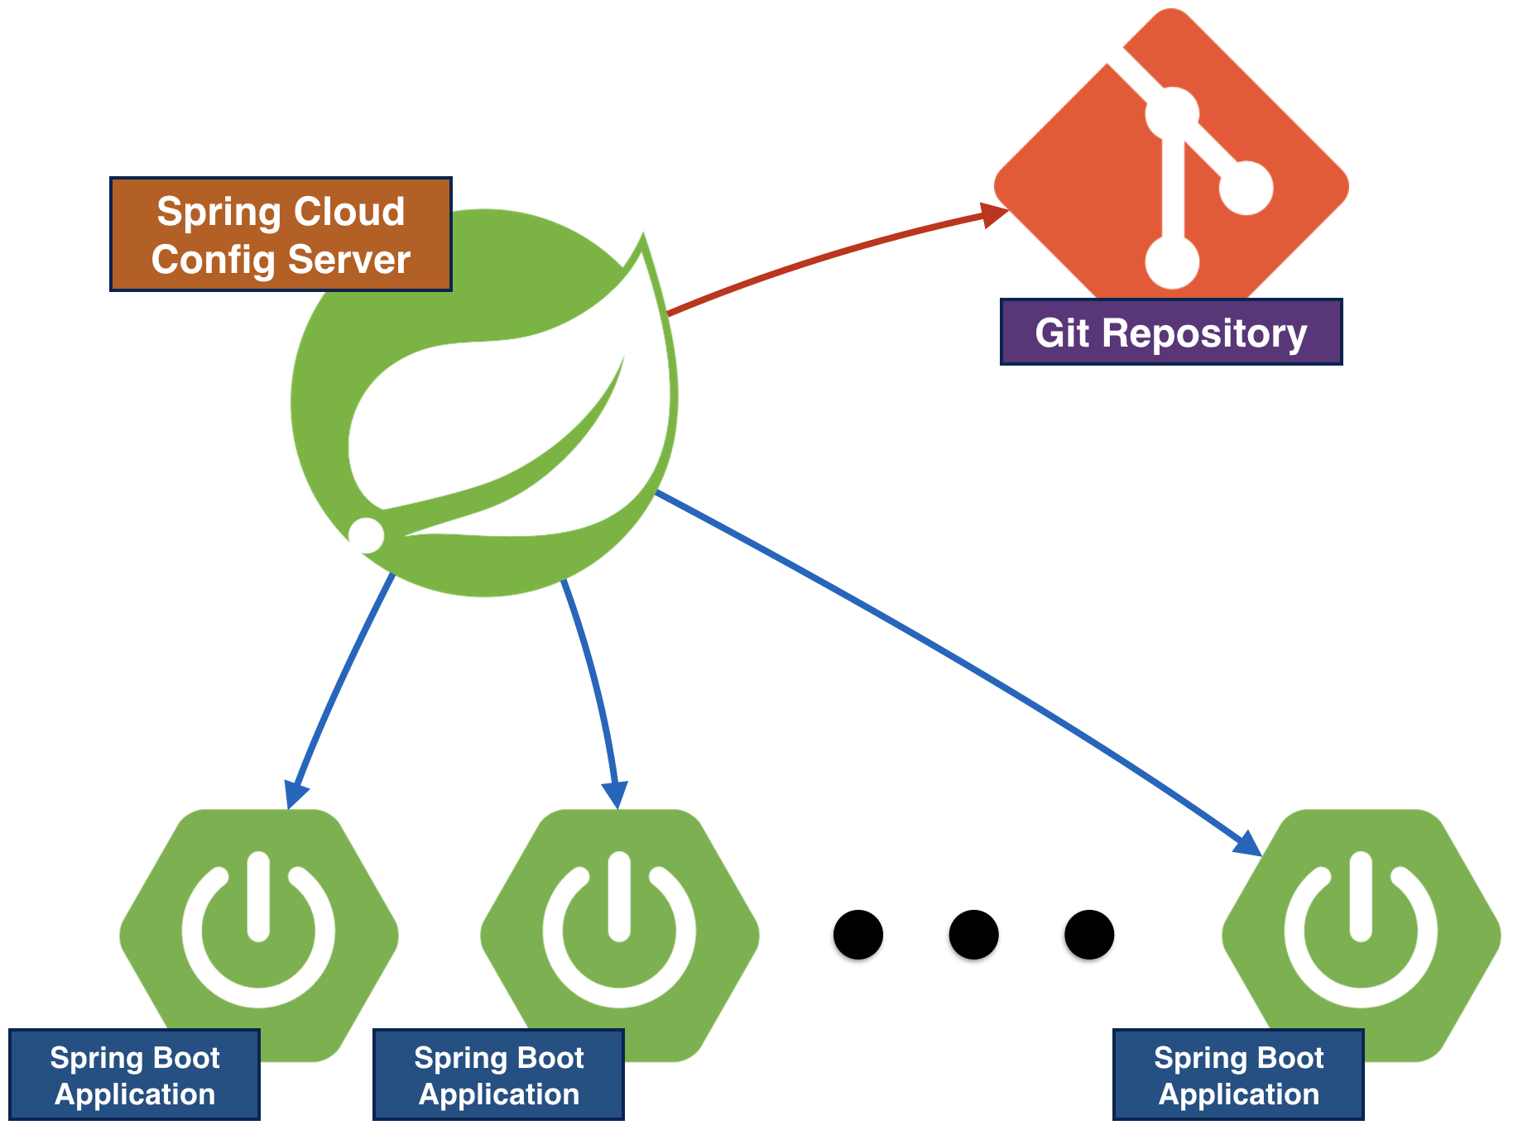
Config
We want to remove the configuration out of the application to a Centralized store across all enviroments.
Spring Cloud Config server can use GIT, SVN, filesystem and Vault to store config
Config Client (Microservice app) retrieve the configuration from the server on startup.

Slide 7
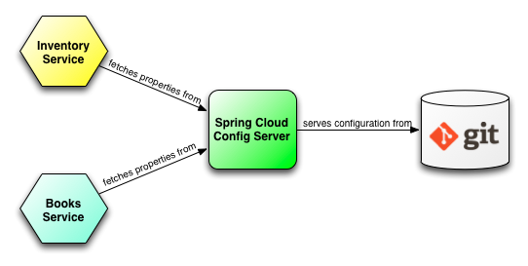
Config

Slide 8
Config Server
Config server holds the details of the configration that can be used in the client.
Each config server refers to one of the GIT repository where we do place required .properties or .yml files
The .properties/.yml files can be for multiple environments e.g.
application.properties -> common for all environments
application_dev.properties -> For DEV environment
application_sit.properties -> For SIT environment
application_prod.properties -> For Prod environment

Slide 9
Steps for writing config server
Add dependency for spring-cloud-starter-config
Add annotation - @EnableConfigServer
Create a GIT repository and clone to your local machine
Configure server location and port in application.properties
Add GIT URI where we store configuration
Add port (usually 8888 for config server)
Now run the test the application through the URL to ensure the application is up and running

Slide 10
Config server – 1. Add dependency
<dependency>
<groupId>org.springframework.cloud</groupId>
<artifactId>spring-cloud-config-server</artifactId>
</dependency>

Slide 11
Config server – 2. Add annotation - @EnableConfigServer
@SpringBootApplication
@EnableConfigServer
public class MyConfigServerApplication {
public static void main(String[] args) {
SpringApplication.run(MyConfigServerApplication.class, args);
}
}

Slide 12
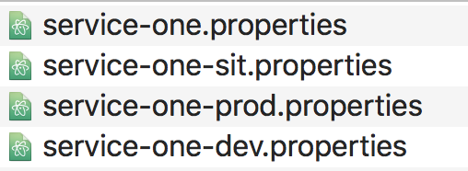
Config server – 3. Create GIT repository & clone to local path
There are different ways. The easiest way is:
Create a repository in the GIT
In your local path, use > git clone <repository URL>
Place the correct configuration (e.g. *.properties)
Commit the file

Slide 13
Config server – 4. Configure server location and port in application.properties
### In MAC ###
spring.cloud.config.server.git.uri=/Users/santoshkumarkar/learning-config-repo
server.port=8888
### In Windows ###
spring.cloud.config.server.git.uri=${USERPROFILE}\\Desktop\\learning-config-repo
server.port=8888

Slide 14
Config server – 4. Testing the URL to ensure the config server is up
Now we have to ensure the config server is up and running.
When the application is up, then only the client can use the configuration from the config server.
http://localhost:8888/<property_file_name>/<profile>
http://localhost:8888/ service-one/dev
OR
http://localhost:8888/ service-one/prod

Slide 15
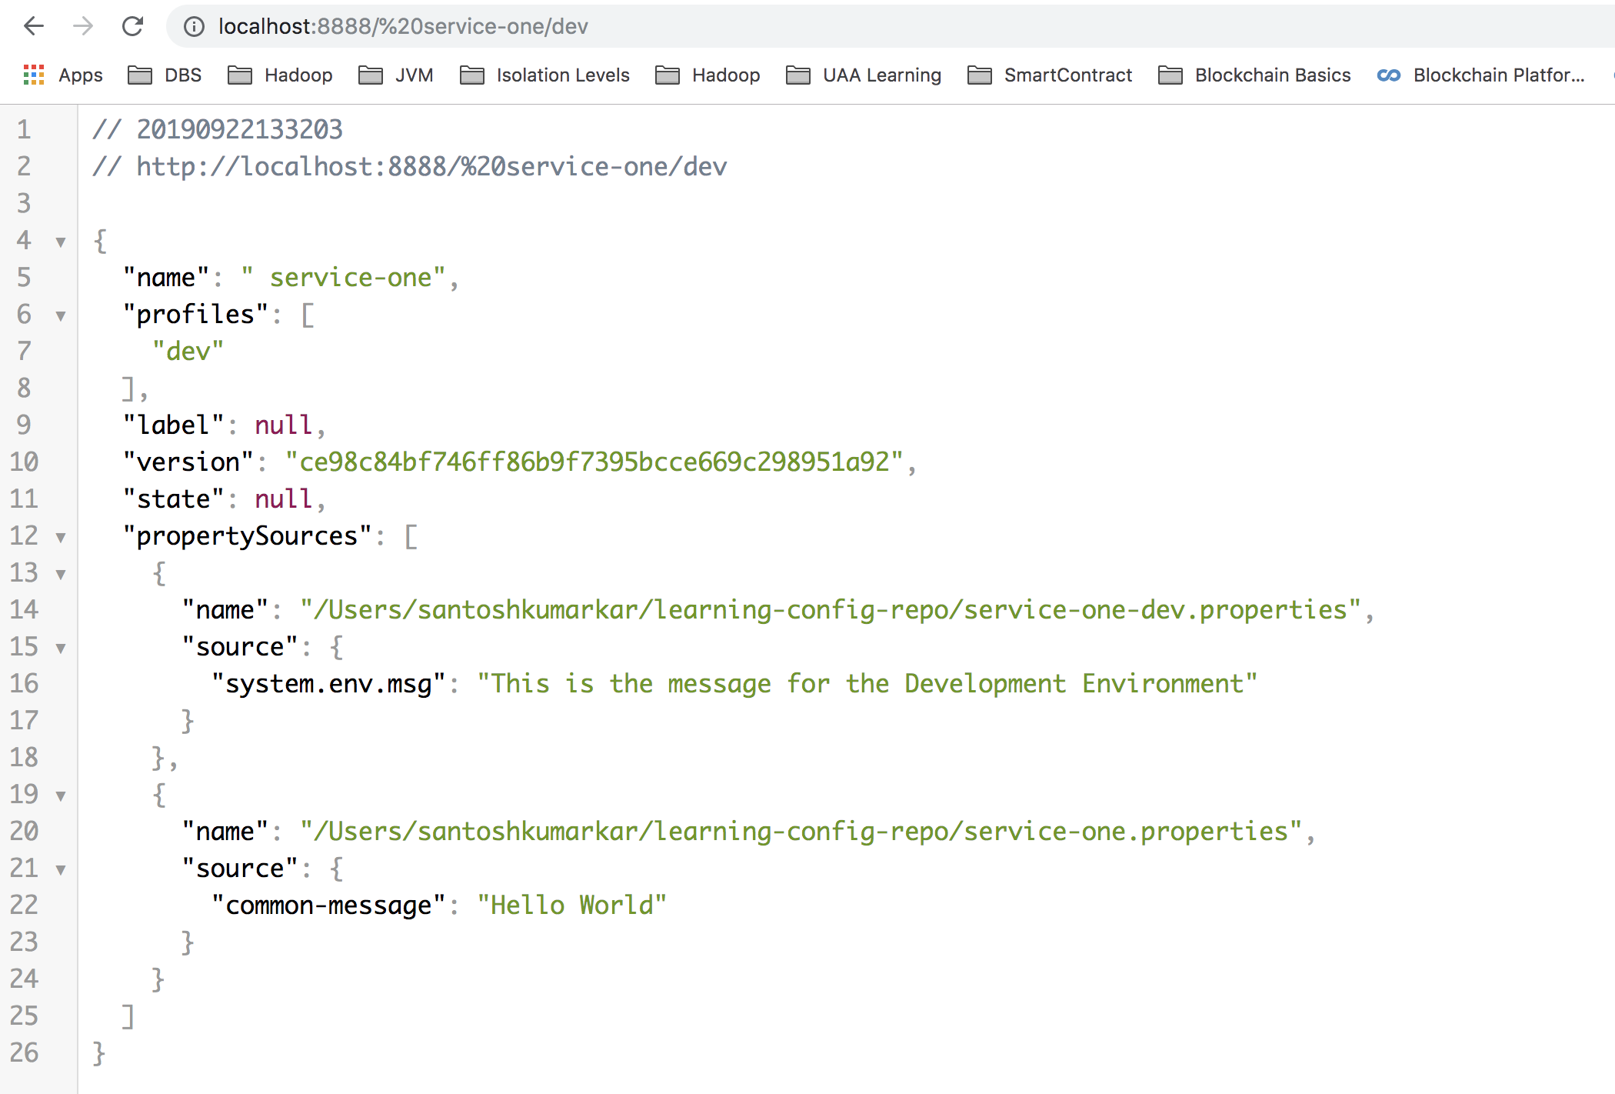
URL

Slide 16
Config Client
Config client is not any specific application. It’s just a simple Microservice
As the main aim of Cloud Config is maintaining centralized configuration, we are NOT going to maintain any configuration properties in the application. Rather we are going to use them.
Before startig the application, it must read the config server details. So required configuration should written in bootstrap.properties/boorstrap.yml
Adding config URI, this is the URL of the config client app
Declare the active profile (e.g. dev or sit or prod)
Please make sure the the config server is up before running the client.

Slide 17
Steps for writing config Client
Add dependency for spring-cloud-starter-config
Define server details in bootstrap.properties to read the configuration from
spring.application.name should be same as the name of property file in config server
spring.cloud.config.uri should be the URL of the config server
spring.profiles.active is the environement to read the correct property file

Slide 18
Config client– 1. Add dependency
<dependency>
<groupId>org.springframework.cloud</groupId>
<artifactId>spring-cloud-starter-config</artifactId>
</dependency>

Slide 19
Config client– 2. bootstrap.properties
The bootstrap.properties/bootstrap.yml is a specific file from Spring Cloud
it’s loaded before the application.properties/application.yml
Please make sure, whatever the name of the property file you use in the config server, you need to use the same name for the application.name in bootstrap.properties
bootstrap.properties
spring.application.name=service-one
spring.cloud.config.uri=http://localhost:8888
spring.profiles.active=dev

Slide 20

Questions
Send to skkar.2k2@gmail.com

